Slide 1
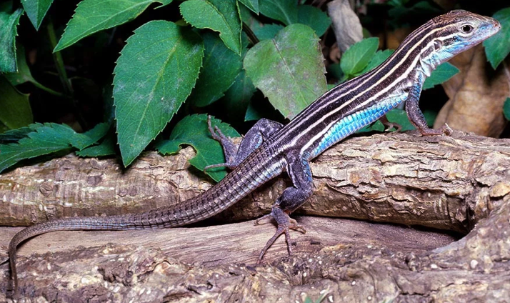
Are Critically Imperiled Six-Lined Racerunner Lizards (Aspidoscelis sexlineatus) Native or Introduced to Michigan?
Quinn S. Moon¹, Anthony J. Barley², Robert C. Thomson¹ ¹University of Hawaiʻi at Mānoa, ²Arizona State University, West Campus

Slide 2
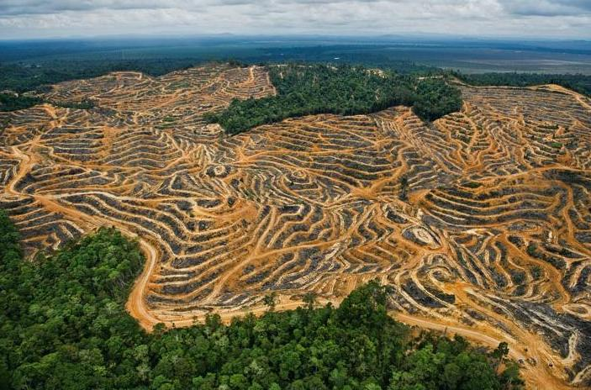
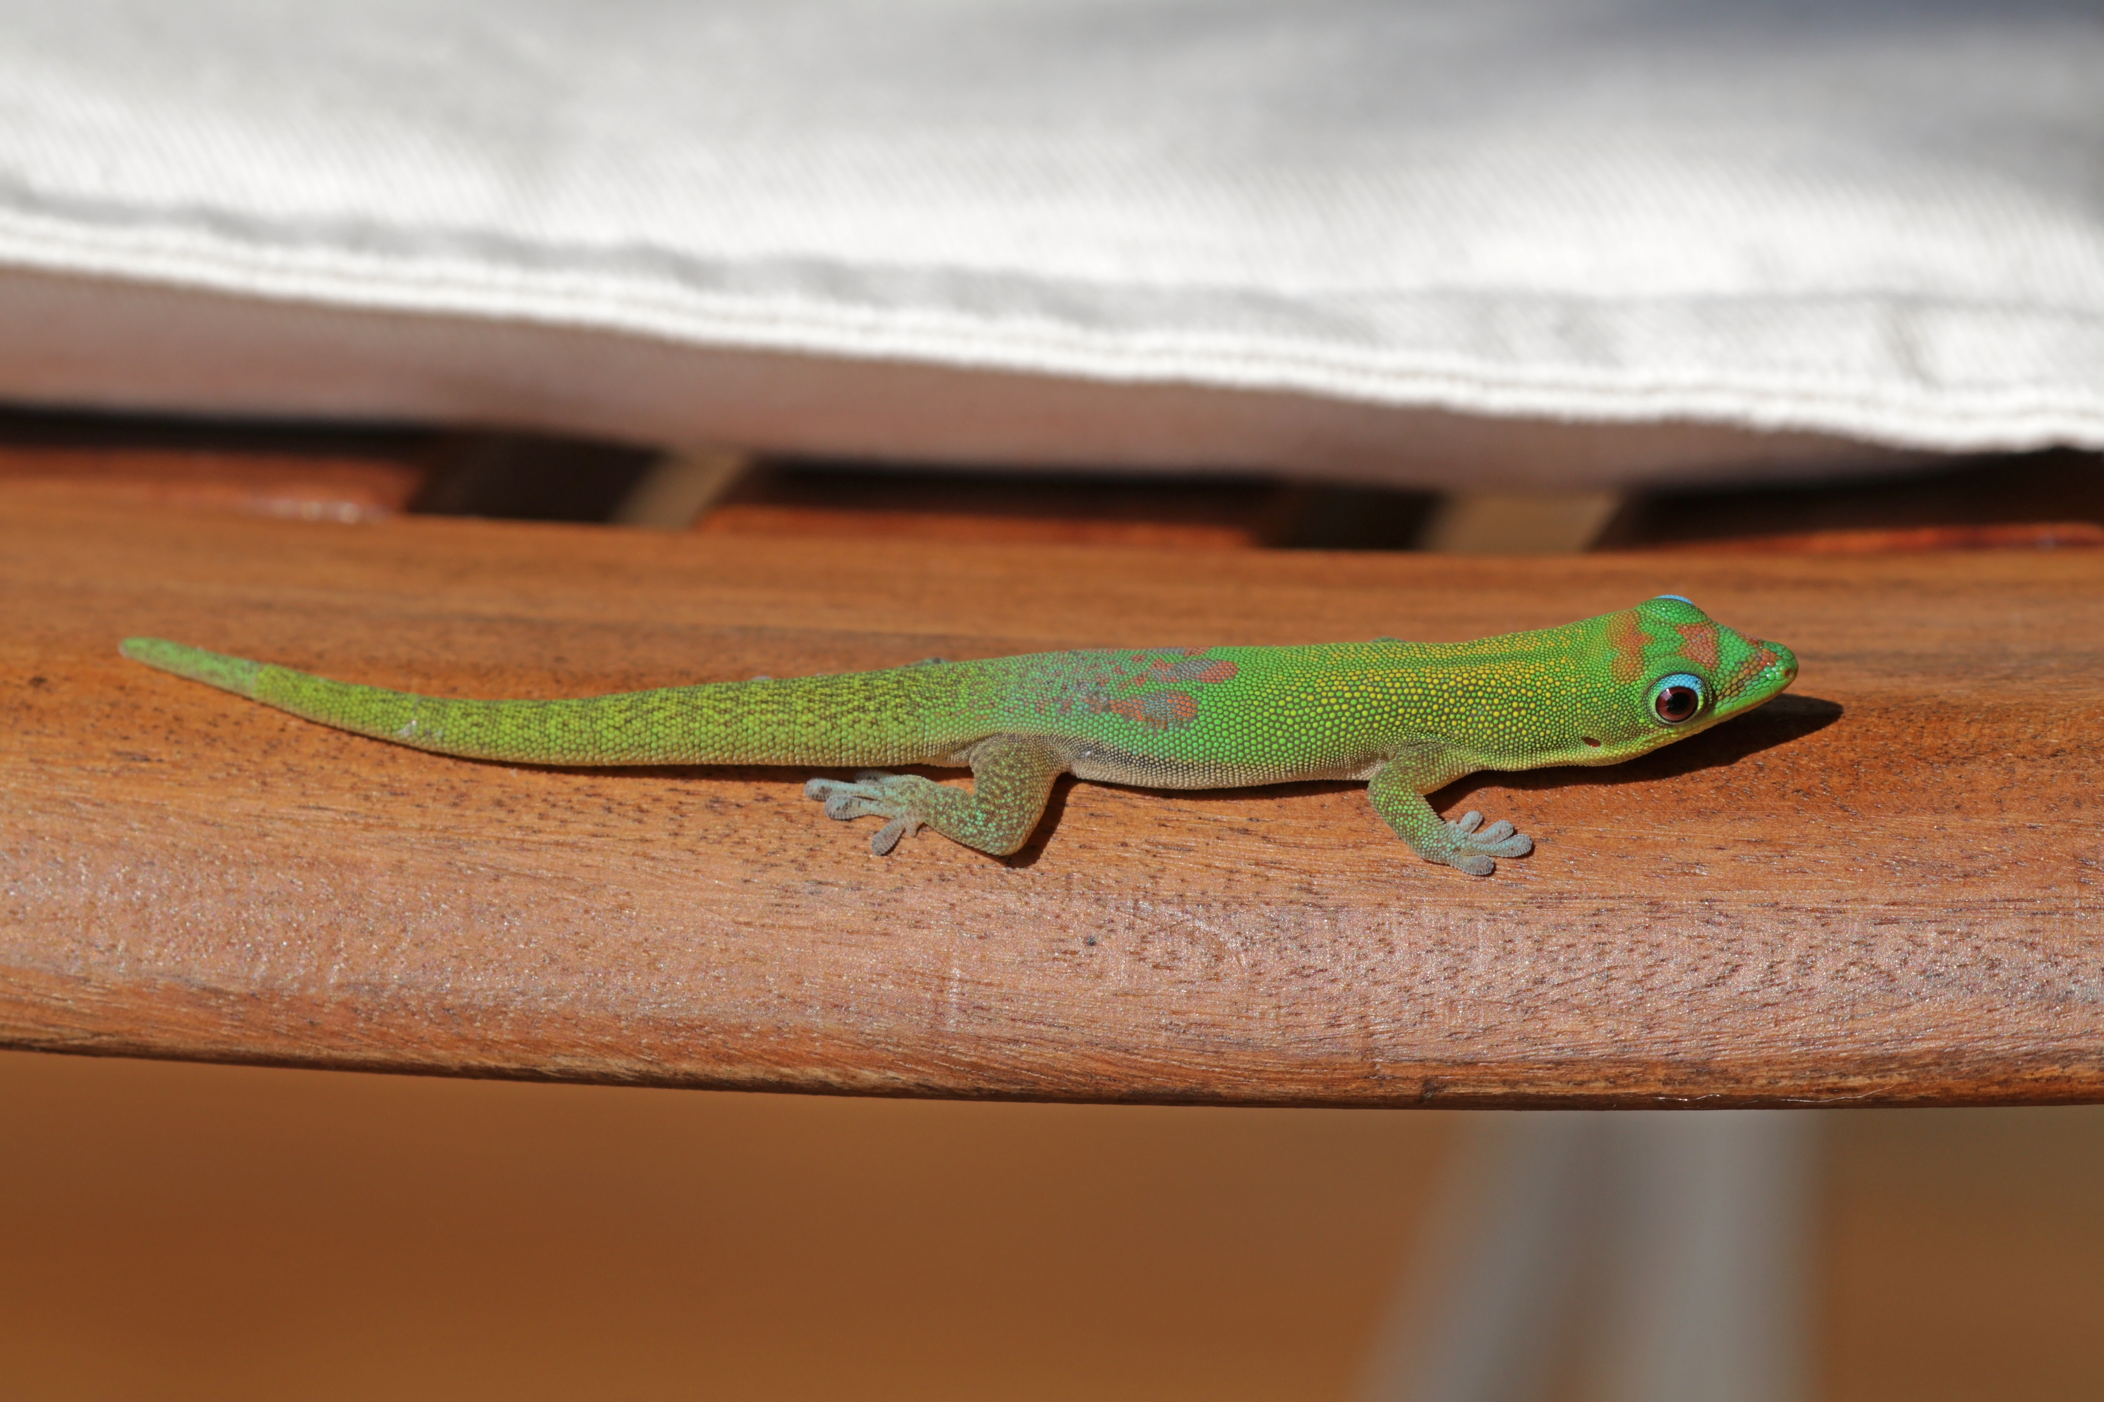
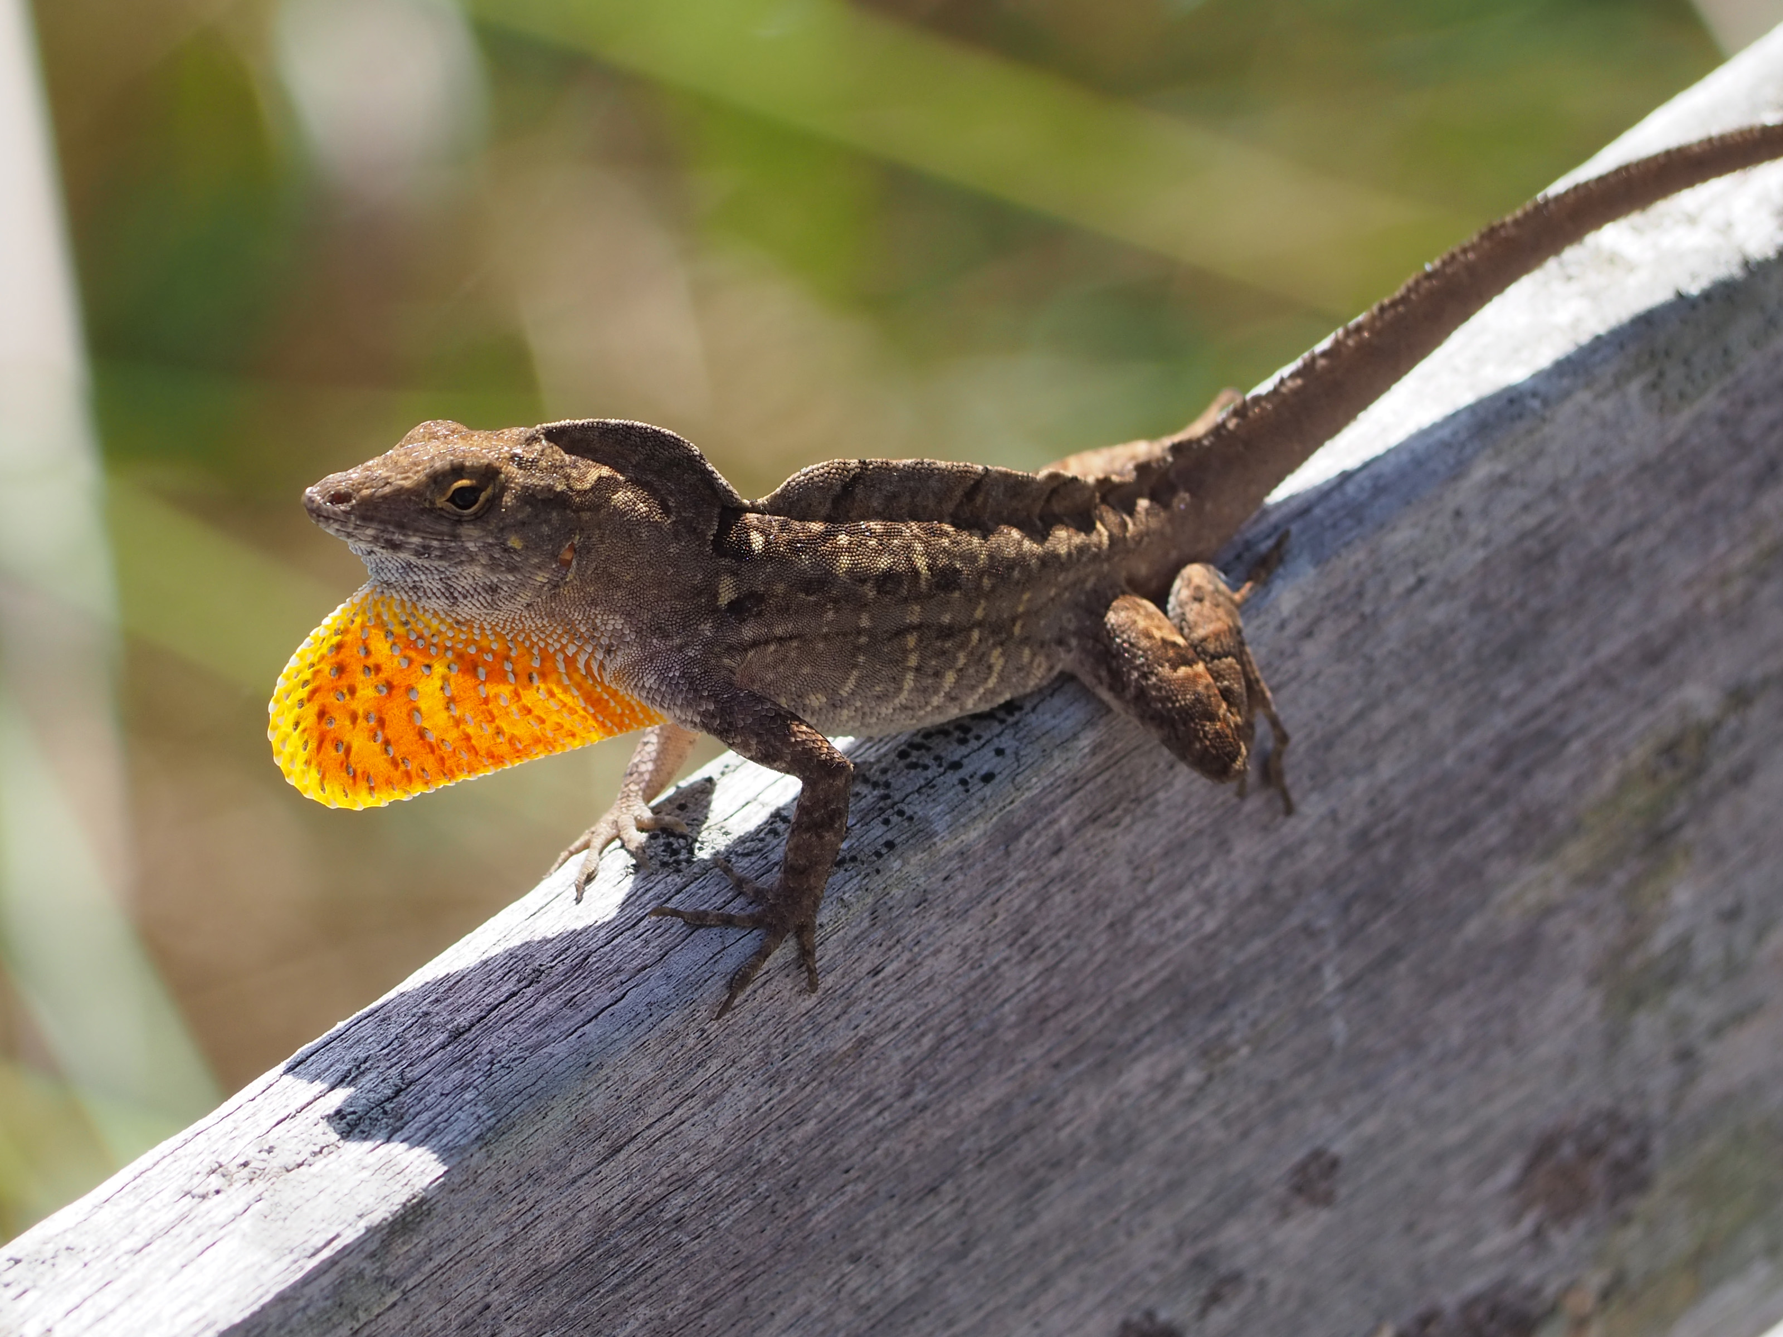
Introduction
Reptiles increasingly threatened with extinction
Isolated populations with unknown origin
Conservation resources, impacts of invasive species, vulnerable native populations
Notes:
Globally, reptiles increasingly threatened.
Principal drivers of decline include : Habitat fragmentation, invasive species, smaller distributional ranges
Isolated- susceptible to extirpation, introduced or native, conservation genetics
Prioritize conservation resources, investigate impacts invasive species, locate and protect vulnerable native populations

Slide 3
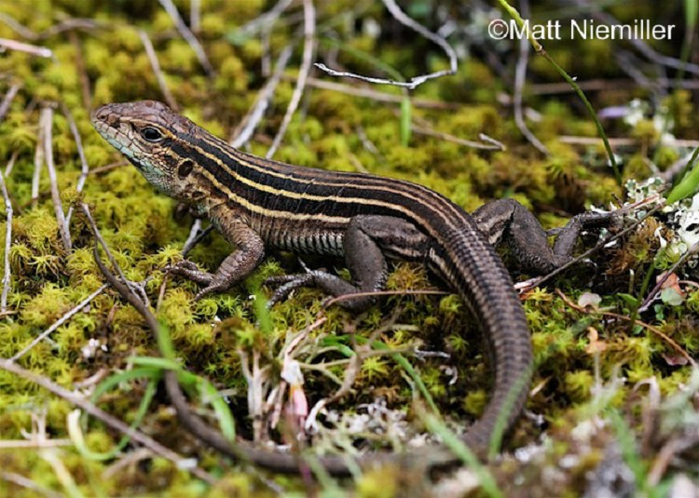
Background
Isolated Six-Lined Racerunner Lizards
Closest population- 322 km away
Murphy Lake State Game Area
Calls for more research
Carlson & Szuch (2005) Herp Rev, Harding & Holman (1990) Mich St Exten, Minton (2001) Indiana Acad Sci
Notes:
In Michigan, Six Lined Racerunner lizards are found in a single park in just county

Slide 4
Background
Isolated Six-Lined Racerunner Lizards
Closest population- 322 km away
Murphy Lake State Game Area
Calls for more research
Listed as native and critically imperiled because of extreme rarity and vulnerable to extirpation
Protected under the Endangered Species Act of the State of Michigan
Carlson & Szuch (2005) Herp Rev, Harding & Holman (1990) Mich St Exten, Minton (2001) Indiana Acad Sci
Notes:
Closest population- 322 km away in Indiana Dunes Region of Northern Indiana
MLSGA- 11 km² in the lower thumb region of Michigan
Detected late 1980s- contains ~450 individuals, reproducing hatchlings
Oral accounts of introduction, Northern Dusky Salamander
Previous inconclusive studies, lead to calls from Herp experts of the region to call for more research

Slide 5
The Study
1. Native
Reptiles removed from Great lakes region ~20,00 years ago
Either post-glacial rapid northward expansion (1) or recent human introduction (2)
Collected 46 museum samples from 40 localities
4 from Indiana/Illinois, 0 Missouri
2. Introduced
Notes:
To address the question on the origin of racerunner lizards in Michigan, we built on knowledge that reptiles removed ~20,00 years ago
Evidence of extensive glaciation during last glacial maximum

Slide 6
The Study
1. Native
Reptiles removed from Great lakes region ~20,00 years ago
Either post-glacial rapid northward expansion (1) or recent human introduction (2)
Collected 46 museum samples from 40 localities
4 from Indiana/Illinois, 0 Missouri
2. Introduced
Notes:
We used phylogenetics to investigate the evolutionary relationships between populations and hopefully inform the management of the population
We hypothesized two settlement pattern into Michigan, either the population is the result of a post glacial northward expansion from Indiana,
And Indiana and Michigan once formed a native and continuous presentation that has since been fragmented and lizards only persist in the park as a refuge.
We predicted that if phylogenetic results group Michigan samples more closely with Indiana, then this would reflect a native population

Slide 7
The Study
1. Native
Reptiles removed from Great lakes region ~20,00 years ago
Either post-glacial rapid northward expansion (1) or recent human introduction (2)
Collected 46 museum samples from 40 localities
4 from Indiana/Illinois, 0 Missouri
2. Introduced
(Missouri)
Notes:
We predicted that if phylogenetic results group Michigan with samples from anywhere in the Range that is not Indiana, then this would reflect a recent anthropogenic introduction.

Slide 8
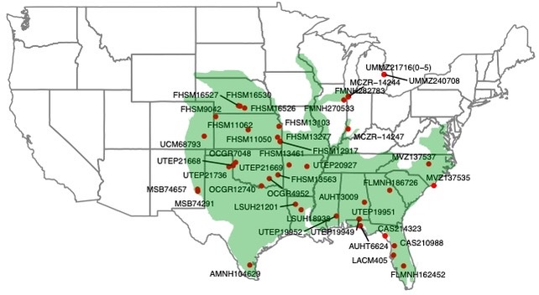
The Study
1. Native
Reptiles removed from Great lakes region ~20,00 years ago
Either post-glacial rapid northward expansion (1) or recent human introduction (2)
Collected 46 museum samples from 40 localities
4 from Indiana/Illinois, 0 Missouri
2. Introduced
Notes:
To test these scenarios, we collected 46 samples from 40 localities. The red dots on this map reflect sampling locations and the green overlay is the general range map of six lined racerunner lizards.
As you can see, we were able to generally collect samples throughout the range to test our hypotheses. However, to the best of our knowledge no samples from Missouri, closest samples from Eastern Kansas

Slide 9
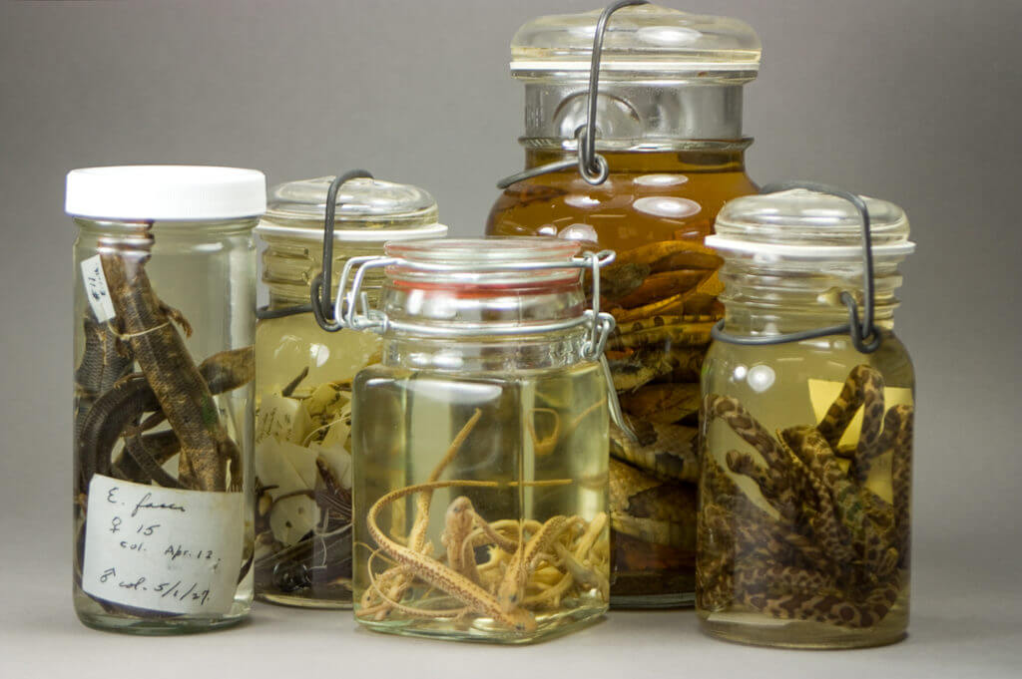
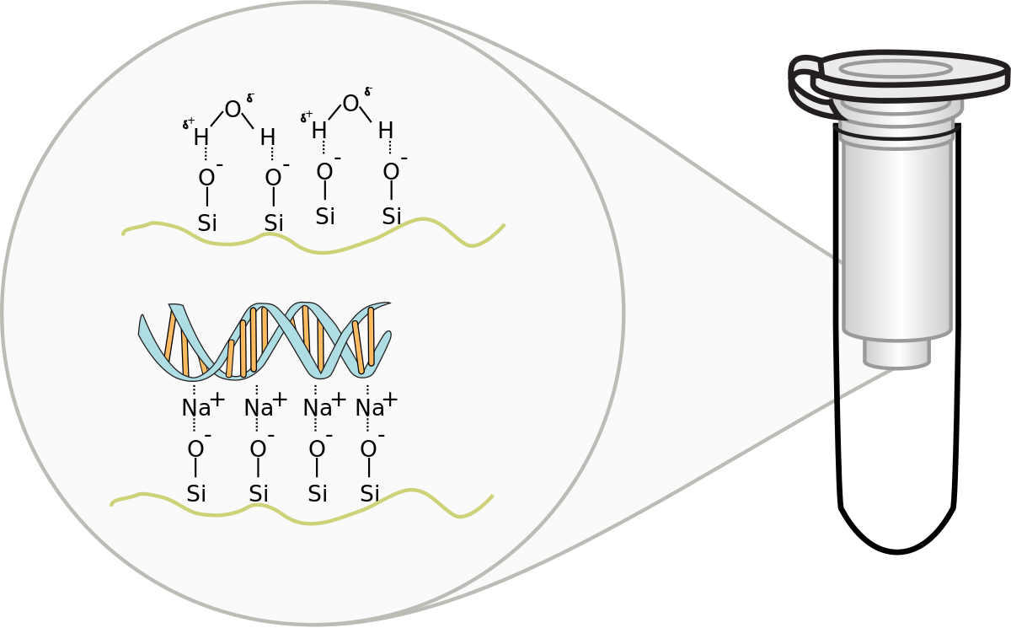
Methods
DNA Extraction
Notes:
Tissue samples were preserved either in 95% ethanol or frozen at -80℃.
DNA extracted and quantified using a Qubit dsDNA BR assay kit
8 of 46 samples failed to yield sufficient DNA
1 sample from Indiana (FMNH28278)

Slide 10
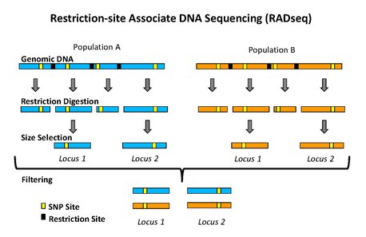
Methods
DNA Extraction
ddRAD
Notes:
In an effort to sample genes from throughout the entire genome, I performed a ddRAD protocol which creates a reduced representation genetic library, or essentially reduced the genome from billions of base pairs down to a set or approx. 20,000 genes that are sequenced and shared for each sample.

Slide 11
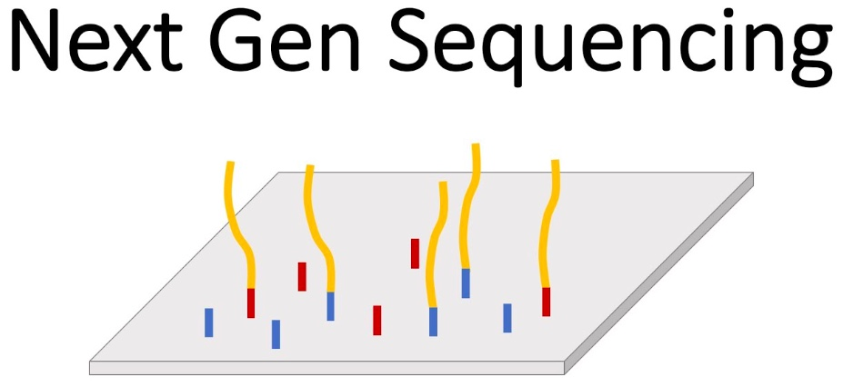
Methods
DNA Extraction
ddRAD
DNA Sequencing
Notes:
Next, we take those shared DNA sequences and send them off for next generation illumine sequencing

Slide 12
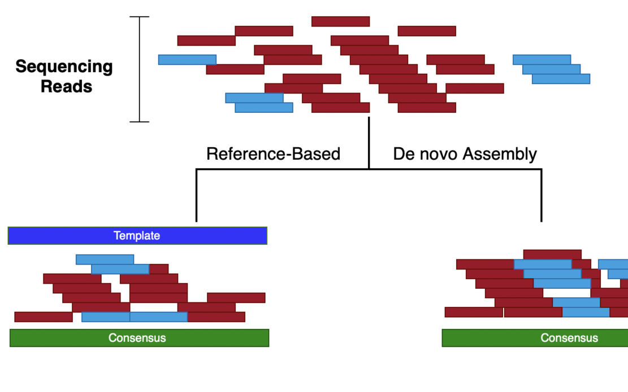
Methods
DNA Extraction
ddRAD
DNA Sequencing
Alignment
Notes:
Next, we align the DNA sequences so they are easier to compare against each other used a reference genome

Slide 13
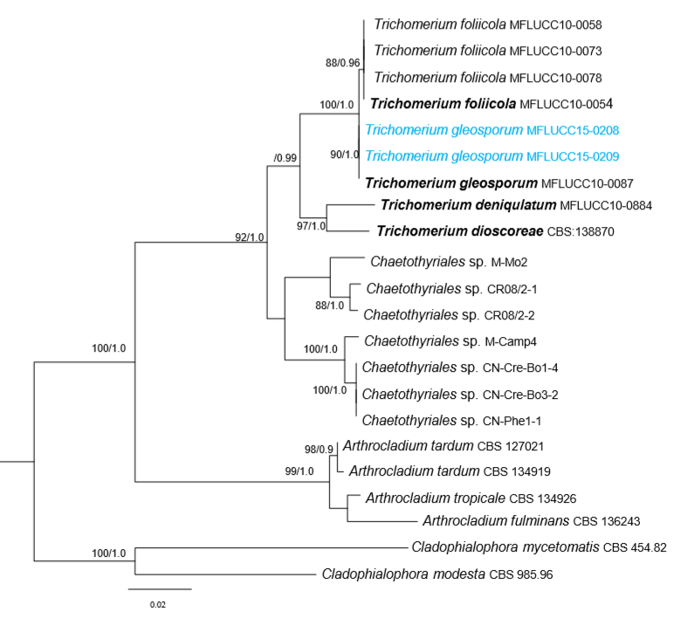
Methods
DNA Extraction
ddRAD
DNA Sequencing
Alignment
Phylogenetic Inference
Notes:
Inferred maximum likelihood phylogenetic trees using RAxML
Phylogenetic trees are essentially A model selects for most likely evolutionary history given the sequence data. We then essentially subsample the data 100 times, called bootstrapping, to test the robustness of the model

Slide 14
Phylogenetic Analysis
Notes:
Evolutionary relationships generally reflected geographic location

Slide 15
Evolutionary relationships generally reflected geographic location
N
S
Notes:
Topology split by geographic location with general pattern that Southern populations are ancestral to more general northern populations

Slide 16
Indiana sample within Michigan samples
Notes:
Sole Indiana Sample is placed in a clade on Michigan samples.

Slide 17
Notes:
IN/MI clade is sister to 13277 from Eastern Kansas, on border with Missouri.
Samples in Orange, KS,NE etc are ancestral to popuations in Red and yellow (eastern most Kansas, MI, IN)
Important to notice here that there are no samples from MO, cannot place on phylogenetic tree

Slide 18
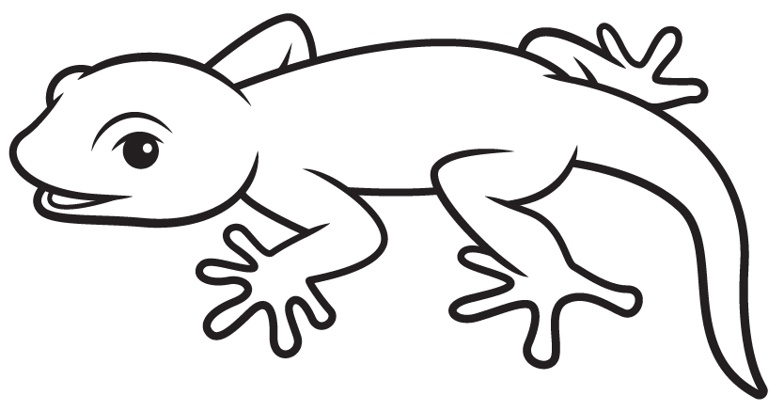
Notes:
Lets visualize these same results on a map. Early populations of sex lined racerunners lived insouthern states like florida, LA, MS, TX

Slide 19
Notes:
Populations began to expand the range north into Arkansas and Oklahoma

Slide 20
Notes:
Range expansion continued northward into NE, KS, CO

Slide 21
Notes:
Finally, our results indicate that populations expanded from eastern Kansas region into Indiana

Slide 22
Notes:
Now, for the population in Michigan, out results support two possible settlement patterns. Based on the close relationship with IN/MI samples, it is certainly possible that lizards continues their expansion north from IN to MI and now remain in MI as a remnant (relic) population

Slide 23
Notes:
Based on the group of IN/MI samples being most closely related to Eastern kansas sample, it is also possible that populations naturally expanded from MO/KS into Indiana followed by a more recent human introduction from KS (or MO) as our background research suggested

Slide 24
Discussion
Unable to directly test MI/MO relationship
Current sampling and topology support introduction from unsampled population (A) or native population (B)
Sampling limitations when working at range edges
Narrow down range of hypothesis
Call for more sampling- field work
Notes:
IN/MI clade was most closely related to Eastern most sample from Kansas (border or Missouri) and descendants of Kansas/NE populations
There are two ways to interpret these results
Either Southern Midwest populations spread into Indiana and Missouri naturally, as shown by solid lines in A. And then lizards were recent transported by humans from MO to MI. In this case, the same midwesten population appears as the ancestor to MO,IN, and IN but resulting topology, because we haven’t samples MO is the same as the Native case B.

Slide 25
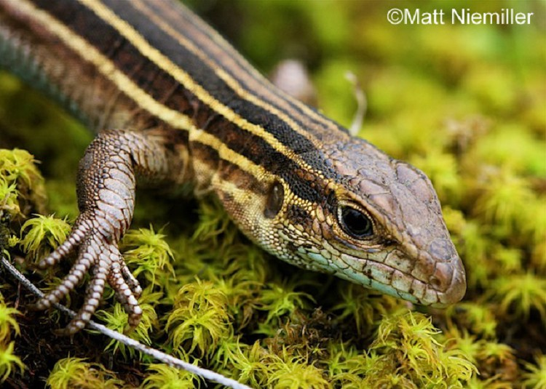

Conservation Recommendation
We recommend that six-lined racerunner lizards continue to be listed as endemic and threatened in the State of Michigan.
Notes:
While increased sampling and analysis of six-lined racerunner lizards may eventually reveal that the Michigan is a recent anthropogenic introduction, given the narrow range, limited population size, and lack of definitive phylogenetic evidence of a recent introduction, we recommend that six-lined racerunner lizards continue to be listed as endemic and threatened in the State of Michigan.

Slide 26





Acknowledgments

Slide 27
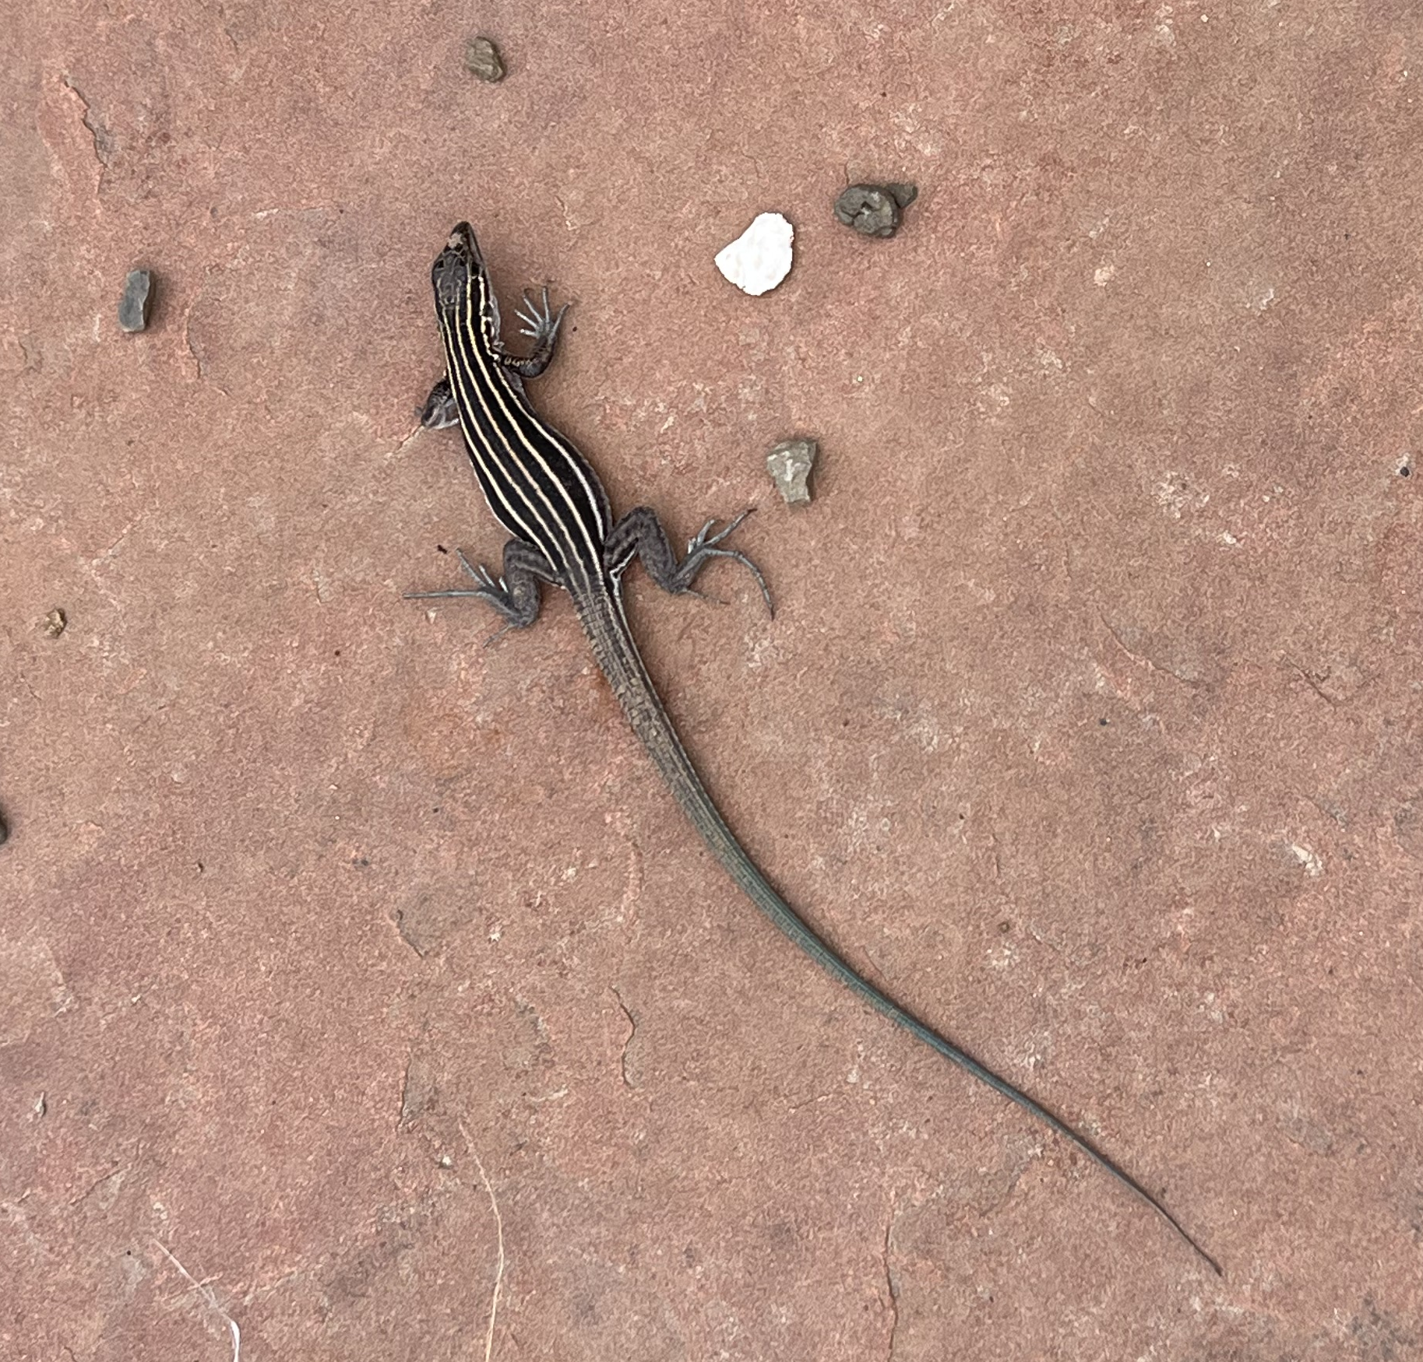
Questions?
Takeaways
Globally reptiles threatened
Isolated population of six-lined racerunner lizards
We recommend six-lined racerunner lizards continue to be listed as native and protected in the state of Michigan
qmoon@hawaii.edu
Notes:
I grew up seeing these lizards in my yard as a kid, I took this picture, and its full circle to study them for my thesis

Slide 28
Museum Samples
We use the following acronyms for collections resources: University of Texas El Paso Biodiversity Collections (UTEP), University of Michigan Museum of Zoology (UMMZ), Louisiana State University Museum of Natural Sciences (LSUH), Oklahoma Collection of Genomic Resources at the Sam Noble Museum (OCGR), American Museum of Natural History (AMNH), Field Museum of Natural History (FMNH), Museum of Vertebrate Zoology at U.C. Berkeley (MVZ), Auburn University Museum of Natural History (AUHT), California Academy of Sciences (CAS), Natural History Museum of Los Angeles County (LACM), Harvard Museum of Comparative Zoology (MCZ), University of Florida Museum of Natural History (FLMNH), University of Colorado Museum of Natural History (UCM), Fort Hays State University Sternberg Museum of Natural History (FHSM), Auburn University Museum of Natural History (AUHT)

